Slide 1

Multi-Model Evaluation of Blackjack Strategies
Deniz Genco ATILLA
Project Advisor : Assist. Prof. Dr. Onur Demir
Deniz Genco ATILLA | 20200702098

Slide 2
Outline
Introduction
Related Work
Analysis
Design and Implementation
Tests and Results
Conclusion
Future Work
Bibliography
Deniz Genco ATILLA | 20200702098

Slide 3
Introduction
This projects aims to explore and evaluate the performances of different Blackjack playing models. These models are:
Brute force models ( Always hit, Always stand, Random Hit/Stand ).
Models that are using Basic Strategy charts and Card Counting.
Historical data analysis model.
Reinforcement Learning based machine learning model.
Evaluating these models in terms of win rate, average return of invest provides us valuable insights into different strengths and weaknesses of each strategy.
Before delving deeper into topic, getting information about the terms of Blackjack might be useful.
Deniz Genco ATILLA | 20200702098

Slide 4
Terms
Blackjack: A card game where the player tries to hold cards that have a value close to 21 but do not go over.
Basic Strategy: The mathematically derived strategy provides an optimal way to play every possible hand in a game of Blackjack, depending on the total in the player’s hand and the dealer’s visible card. This strategy is meant to minimize the house edge.
House Edge: The mathematical expectation a casino has over its players, realized as a percentage of the player’s original bet and is the average gross profit the casino will likely make from each bet.
Card Counting: A strategy to search the high-to-low card ratio to be dealt in the remainder of the deck.
High Cards: Cards that are 10 and over (Jack, Queen, King, Ace) these cards place the player in an advantaged position of hitting Blackjack
Low Cards: Cards that are six and below (2, 3, 4, 5, 6) valued cards are generally less favorable to the player.
Deniz Genco ATILLA | 20200702098

Slide 5
Terms
Historical Data Analysis: Involves the analysis of past game outcomes and player decisions to get possible patterns and extract strategies.
Win Rate: The percentage of games a player or model has won versus some number of games played.
Average Return: The average amount of money won or lost per game, calculated over many games. It gives one an idea of the profitability of a Blackjack strategy.
Deniz Genco ATILLA | 20200702098

Slide 6
Problem Definition
The project aims toward giving an objective for various playing and analysis strategies in the game of blackjack by simulation, with the end game being able to identify the best approach that provides maximum profit for players.
Therefore, it is multi-dimensional in designing, implementing, and evaluating many models because of the unique strategies of implementing games during decision-making, brute force strategies, basic strategy with and without counting, historical data, and reinforcement learning models.
Adapting these models will make it a comprehensively applicable tool for blackjack strategy analysis that combines detailed simulation with an intuitive interface to provide insights into the comparison between effective differences in playing strategies.
Deniz Genco ATILLA | 20200702098

Slide 7
Related Work for Basic Strategy
The concept of an ideal strategy in Blackjack is inspired studies for many years. The foundation on which the present basic strategy rests was that published in essence by Roger R. Baldwin, Wilbert E. Cantey, Herbert Maisel and James P. McDermott in 1956 paper called "The Optimum Strategy in Blackjack." A mathematically based strategy for players to use to minimize the house edge.
It covers actions to take in different dealer hands, some specific actions like “doubling down” and “splitting pairs” and when to do them they demonstrate them by calculating all the probabilities in these situations.
Deniz Genco ATILLA | 20200702098

Slide 8
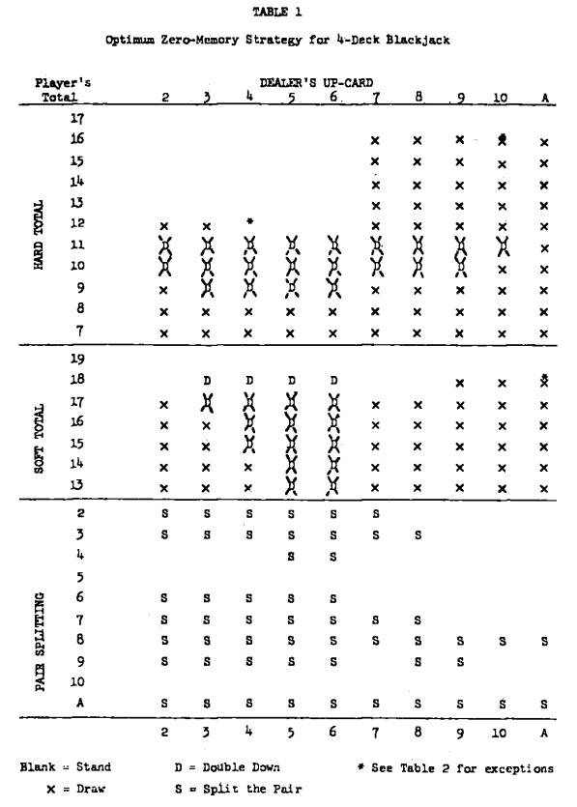
Related Work for Basic Strategy
Further advancements were made by A. R. Manson, A. J. Barr and J. H. Goodnight in paper "Optimum Zero-Memory Strategy and Exact Probabilities for 4-Deck Blackjack," published in 1975. This research provided a detailed analysis of optimal strategies for multi-deck Blackjack games. In Figure 1.1 we can see that a probalistic table turned into what is called Basic Strategy chart, that shows the action player should have in which hand player versus dealer.
For example for player hand 14 (assuming that hand is a hard hand) versus dealer hand 9 this chart suggests user to draw a card.
Figure 1.1 : Optimum Zero-Memory Strategy for 4-Deck Blackjack ^{[1]}
Deniz Genco ATILLA | 20200702098

Slide 9
Related Work for Card Counting Methods
Card counting, a technique that involves tracking the ratio of high to low cards remaining in the deck, was popularized by Edward O. Thorp in his book “Beat the Dealer”^{[2]}.The effectiveness of card counting as a strategy was further explored and mathematically validated in subsequent studies.
In 1973, I. Archer published his book, “The Archer Method of Playing 21”^{[3]}, where he describes in detail the developed system, which later became known as the "Archer Method" and is the first published card counting system for playing blackjack.
In the Archer method, the player keeps track of the ratio of high cards to low cards in the deck and bets either more or less according to his calculated advantage and optimal strategy. This book gave a mathematical foundation to the Archer Method, and he offered practical advice on how it might be applied at the casino tables playing blackjack.
Deniz Genco ATILLA | 20200702098

Slide 10
Related Work for Machine Learning
A significant contribution to the field was made in 1992 by S. Yakowitz and M. Kollier, a paper that provided an in-depth analysis of the efficacy of card counting using machine learning techniques. Their work transcribed the search for optimal counting strategies in blackjack into the task of finding a global minimum of a multi-modal discontinuous objective function based on noisy measurements. This approach, termed 'stochastic minimization,' required minimal modeling or understanding of the problem structure. It contrasted with earlier analyses by Thorp, Braum, and others, who relied heavily on combinatorics.
Deniz Genco ATILLA | 20200702098

Slide 11
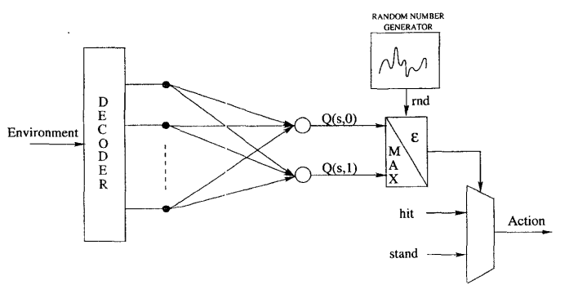
Related Work for Machine Learning
A another notable study by Perez-Uribe, A. and Sanchez, E. ⁴ in 1998 explores the use of blackjack as a test bed for neural network-based learning strategies, with a particular focus on reinforcement learning techniques.
This research highlights how reinforcement learning allows the system to autonomously develop a strategy by experimenting with various actions, leading to improved performance over time. Performance comparisons with earlier approaches demonstrate the advancements achieved through these modern techniques, offering a fresh perspective on optimizing gameplay in blackjack.
Perez-Uribe, A and Sanchez, E has used SARSA algorithm for reinforcement learning as we later also see, I used Q learning algorithm for it.
Figure 1.2 Neural Network Arcitecture ^{[4]}
Deniz Genco ATILLA | 20200702098

Slide 12
Analysis
Deniz Genco ATILLA | 20200702098

Slide 13
Analysis Outline
Card, Deck and Hand systems
Algorithms
Brute Force
Always Hit
Always Stand
Random Hit/Stand
Basic Strategy without Card Counting
Basic Strategy with Card Counting
Historical Data
Reinforcement Learning
Deniz Genco ATILLA | 20200702098

Slide 14
Card, Deck and Hand Systems
Cards essential tools to play Blackjack. Each card has a suit and a color, these colors are by the tradition are red and black. Suits are generally French-suited; hearts, diamonds, clubs, and spades.
A standard deck has 52 playing cards. In project deck class also has a deck creation and shuffling functions. Shuffle function uses built in random.shuffle function to shuffle cards in a deck.
Hand class is representation of the cards that player or dealer holding. It holds the cards as “card suit” and “card number”, then in get_value function shrinks it into a integer value that algorithms can use.
Deniz Genco ATILLA | 20200702098

Slide 15
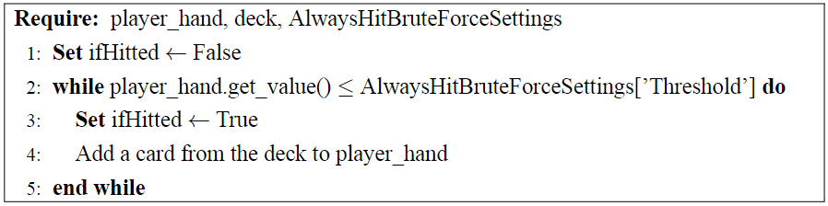
Always Hit Brute Force
The always hit strategy as it name suggests, always requesting a card from dealer. But if there wasn’t a threshold-like mechanism player will lose all the time. So by setting that threshold, algorithm is ready to start. It will hit for new cards until its hand value reaches that threshold. But there is a catch, fine-tuning the threshold is quite important step since setting it too high or low might reduce the performance and profitability of the model. Following is the psudocode for this algorithm’s decision making part:
Figure 2.1 Always Hit Brute Force Algorithm
Deniz Genco ATILLA | 20200702098

Slide 16
Always Stand Brute Force
The always stand strategy, involves the player standing, not requesting additional cards, regardless of the total value of its hand. This strategy is based on a conservative approach, aiming to avoid the risk of busting. However since having a weak hand and standing to it might often results to fewer wins, we can assume that this algorithm have less performance and profitability according to other models.
Since, this algorithm doesn’t include any action taking mechanism for player side. It only creates the initial hands, plays for dealer then completes its simulation.
Deniz Genco ATILLA | 20200702098

Slide 17
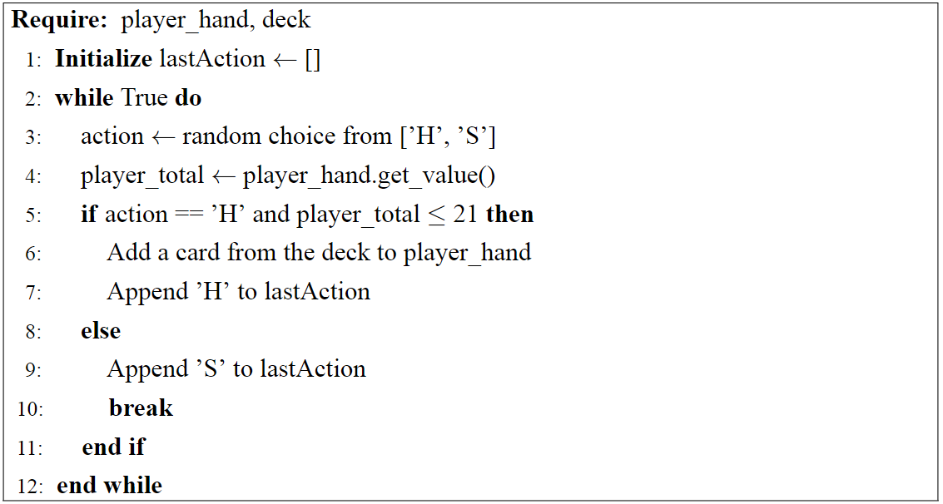
Random Hit/Stand Brute Force
The random hit/stand strategy introduces a random possibility into players’ decision making process. Player chooses to either hit or stand based on a probabilistic model. Since this random actions, frequently leads to less optimal calls, either hitting when it ought to be staying put, or staying put when it ought to be hitting therefore it might lower the performance and proftiablity of the model.
As we can seen in random hit/stand algorihm’s decision making psudocode in Figure 2.2 at 3rd line there is a random selection between Hit and Stand actions. Based on this selection, the corresponding action is executed.
Figure 2.2 : Random Hit/Stand Brute Force Algorithm
Deniz Genco ATILLA | 20200702098

Slide 18
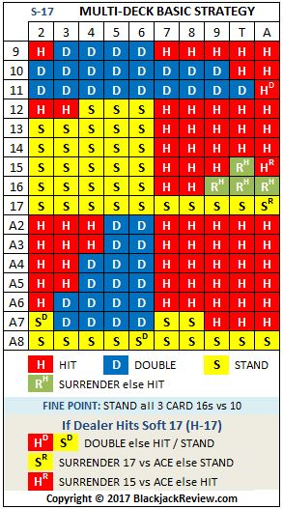
Basic Strategy without Card Counting
Basic strategy models develop based on a mathematically derived set of rules formulated to minimize the house edge in Blackjack. These rules, called basic strategy, provide the player with the best action to take in any situation presented, given their hand and the dealer's upcard.
The basic strategy charts graphically illustrate all the optimum plays, given every possible combination of the player's hands and the dealer's upcard.
Figure 2.3 : Basic Strategy Chart^{[6]}
Deniz Genco ATILLA | 20200702098

Slide 19
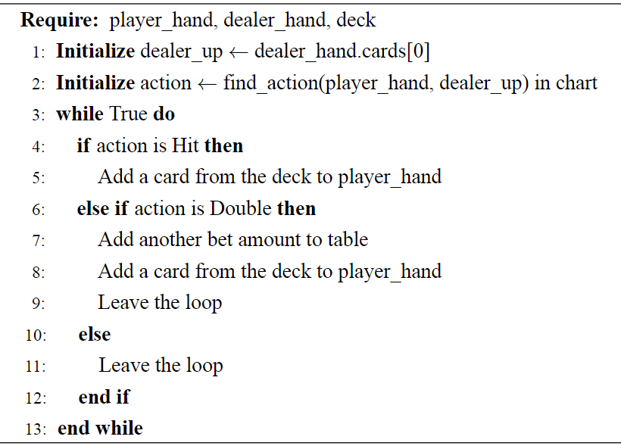
Basic Strategy without Card Counting
There are 3 main parts of a Basic Strategy algorithm these are setting input parameters, finding the right action with chart lookup and decision making.
In 1st row, dealer up card is set to make chart lookup easier.
Then in 2nd row a chart lookup is done, and according to player hand and dealer up card according action gathered.
Finally, gathered action will be applied, however hand of player might still can be playable in that case this process is repeated until a stand action comes up.
Figure 2.4 : Basic Strategy without Card Counting Algorithm
Deniz Genco ATILLA | 20200702098

Slide 20
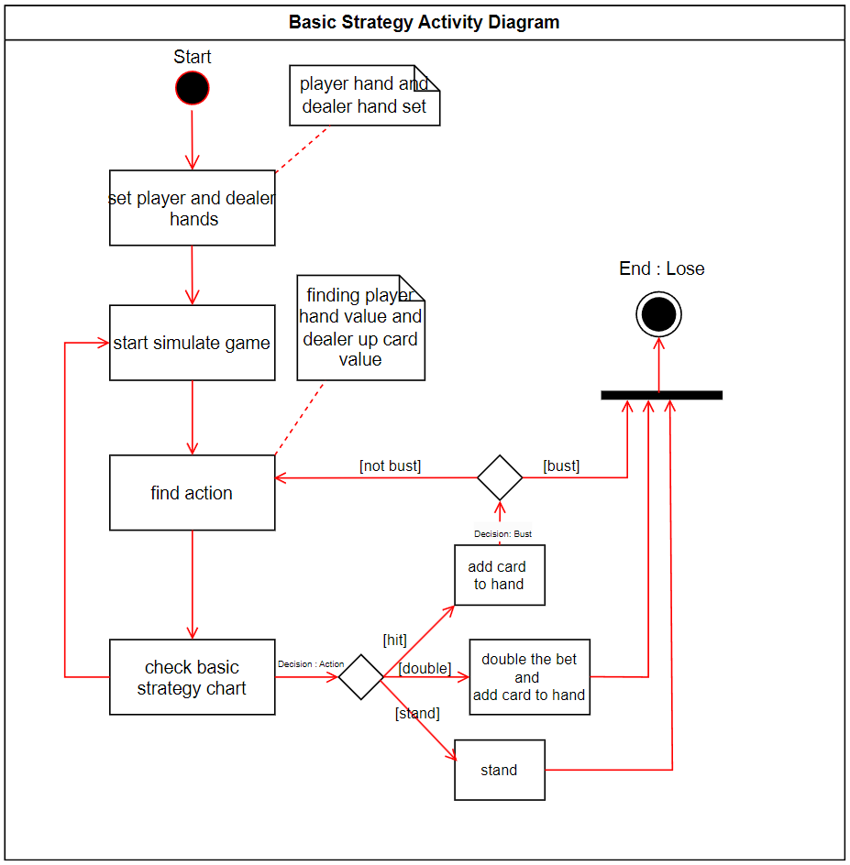
Basic Strategy without Card Counting
Figure 2.5 : Activity Diagram of Basic Strategy without Card Counting Algorithm
Deniz Genco ATILLA | 20200702098

Slide 21
Basic Strategy with Card Counting
Card counting is a technique used in Blackjack to track the ratio of high cards (10s, face cards, and Aces) to low cards (2 through 6) remaining in the deck. Basic principle is that a deck with a higher part of the cards is advantageous for the player, as it increases the chance of achieving a blackjack and advantageous doubling down situations.
Card counting has 4 steps in order to work these are:
Assigning Values to Cards : Most counting strategies use a Hi-Lo based value assigning.
2 to 6 : + 1
7 to 9 : 0
10, Jack, Queen, King and Ace : - 1
Calculating Running Count : As the cards dealt, player needs to calculate cards Hi-Lo values in a total summation.
Calculating True Count : To get a more accurate evaluation on decks favorability, running count is divided by remaining deck amount and this provides true count.
Adjusting the Bet : The most important part of the algorithm to get a better odds against house edge. Player should adjust its bet according to true count, when true count is high (favorable deck) player should increase bet and vice versa.
Deniz Genco ATILLA | 20200702098

Slide 22
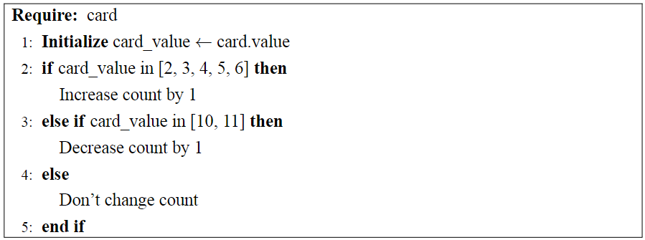
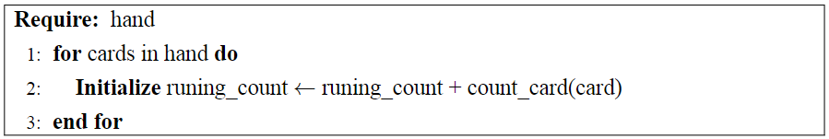
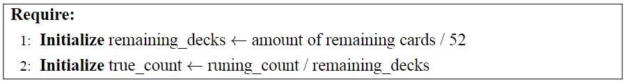
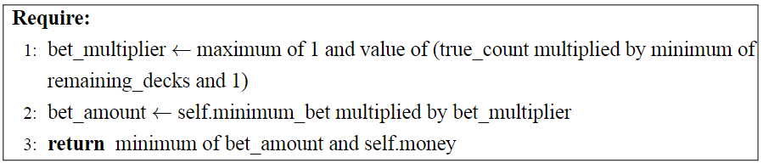
Basic Strategy with Card Counting
In Figure 2.6 a counting algorithm can be seen, in a basic condition statement, by checking the value of the cards with the help of the function at Figure 2.7 running count is calculating at each card dealing action.
And finally in Figure 2.8 by dividing the running count into remaining decks in table true count will be gathered.
Algorithm first calculates new bet amount with function at Figure 2.9 according to current true count of table then again creates a lookup for basic strategy chart and does its actions.
Figure 2.6 : Counting Algorithm For Card Counting
Figure 2.7 : Calculating the running count For Card Counting
Figure 2.8 : Calculating true count For Card Counting
Figure 2.9 : Bet adjusting according to true count
Deniz Genco ATILLA | 20200702098

Slide 23
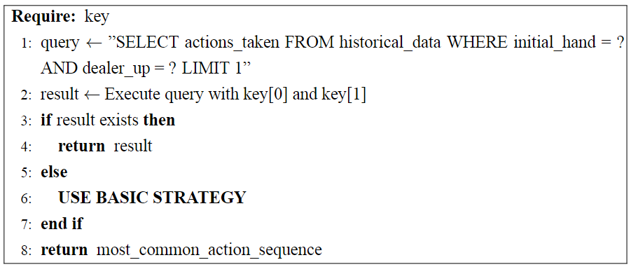
Historical Data
The Historical Data model leverages a large dataset of 50 million Blackjack hands^{[7]} to determine the optimal actions based on historical outcomes. This dataset, sourced from Kaggle, provides a comprehensive collection of simulated Blackjack hands, reflecting various scenarios and outcomes based on basic strategy.
By using initial hand, dealer up card and action taken from this dataset this algorithm can predict the best action for any given hand based on empirical evidence from millions of simulated plays.
In Figure 2.10 psudocode of this algorithm can be seen. In line 1 a query is created where intital hand and dealer up card is set and then this query is executed to find corresponding action.
If that player and dealer not occurs in historical data then basic strategy will be applied.
Figure 2.10 : Checking algorithm for action to execute.
Deniz Genco ATILLA | 20200702098

Slide 24
Reinforcement Learning
Reinforcement Learning (RL) is a type of machine learning where an agent learns to make decisions by performing actions in an environment to maximize the final rewards. RL involves learning through interaction with the environment, receiving feedback in the form of rewards or penalties, and using this feedback to improve future actions.
These are the some of the key steps to create a reinforcement learning model:
Defining Environment : Environment is the states, actions and reward structure of the place agent operates. In blackjack scope; agent is player, states are player’s hand vs. dealer’s up card, actions are hit, stand and double. And rewarding is determined according to winning and losing game.
Initialization the Q-Table : Q-Table is a table that stores the expected rewards for each state-action pair.
Choosing the Hyper-parameters : Setting values like learning rate (alpha), discount factor (gamma) and exploration rate (epsilon).
Training the model : Running multiple ”episodes” where the agent interacts with the environment and learns from the outcomes.
Deniz Genco ATILLA | 20200702098

Slide 25
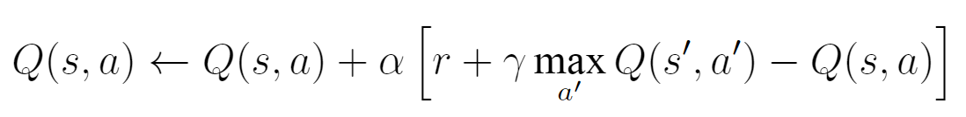
Explanation of Q-Learning
Q-learning is a reinforcement learning algorithm that aims to learn the value of the optimal action-selection policy. It uses a Q-Table to store the expected rewards for each state-action pair. The Q-learning algorithm updates the Q-Table based on the Bellman equation:
where:
Q(s, a) is the current value of the state-action pair.
α is the learning rate.
r is the reward received after taking action a.
γ is the discount factor.
s′ is the next state.
max a′ Q(s′, a′) is the maximum expected future reward for the next state-action pair.
Deniz Genco ATILLA | 20200702098

Slide 26
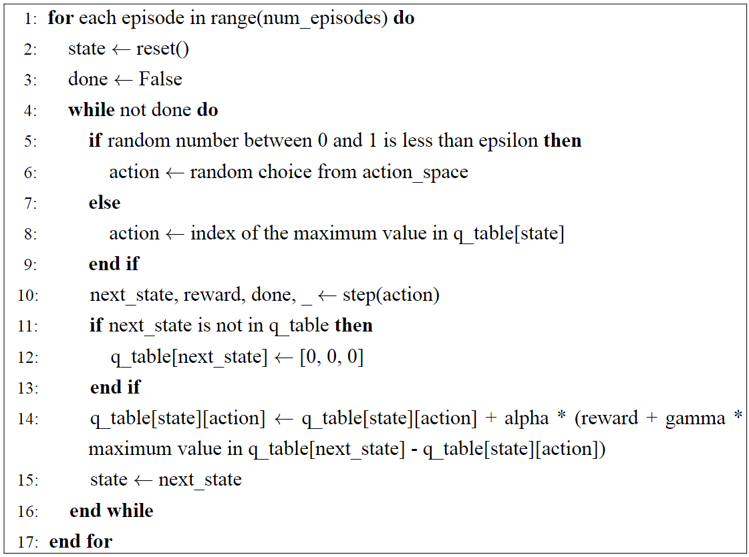
Reinforcement Learning
Figure 2.11 shows training an agent using the Q-learning algorithm training it in continuous episodes.
Inside an episode, an ε-greedy policy dictates the agent’s choice of action—exploration of new strategies versus exploitation of known optimal actions.
After the action is done, the environment provides feedback which it indicates the next state, reward, and whether the episode is over or not. If the next state is new, it is added to the table of Q-values with initial values.
The Q-value for the current state and action pair is updated through the Bellman equation where the agent averages the immediate reward and estimate of future rewards. This enables the agent to iteratively update its strategy to maximize the reward.
Figure 2.11 : Psudocode for Train Model
Deniz Genco ATILLA | 20200702098

Slide 27
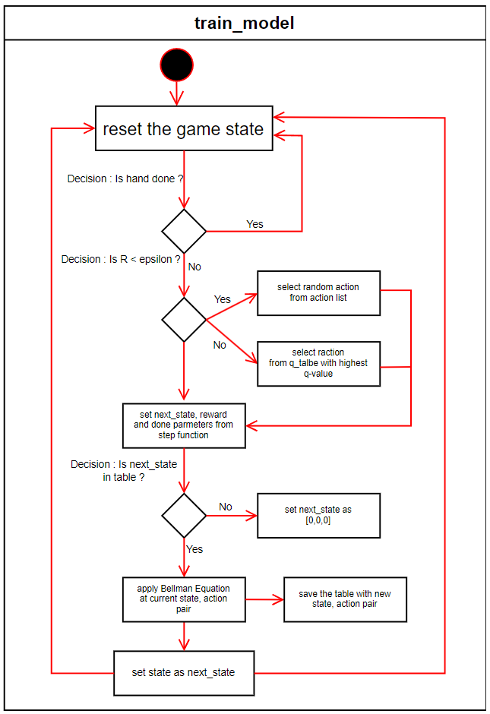
Reinforcement Learning
Figure 2.5 : Activity Diagram of Train Model Algorithm
Deniz Genco ATILLA | 20200702098

Slide 28
Design and Implementation
Deniz Genco ATILLA | 20200702098

Slide 29
Design and Implementation
The implementation of the algorithms for the models, user interface, and graphs are all
written in Python. The majority of the algorithms utilize the Pandas library for handling data
and saving the outputs of the simulations into Excel files for later analysis.
For the Historical Data analysis model, SQLite is used to store .csv files into a local database, allowing for faster data searching compared to reading and searching within a .csv file directly.
The reinforcement learning (RL) model employs the pickle library for serialization, enabling the saving of the Q-table to a file for future use in determining actions during the blackjack game.
Graph creation within the user interface leverages the matplotlib and seaborn libraries, providing
robust tools for data visualization. The entire graphical user interface (GUI) is developed using PyQt6, ensuring a rich and interactive user experience.
Deniz Genco ATILLA | 20200702098

Slide 30
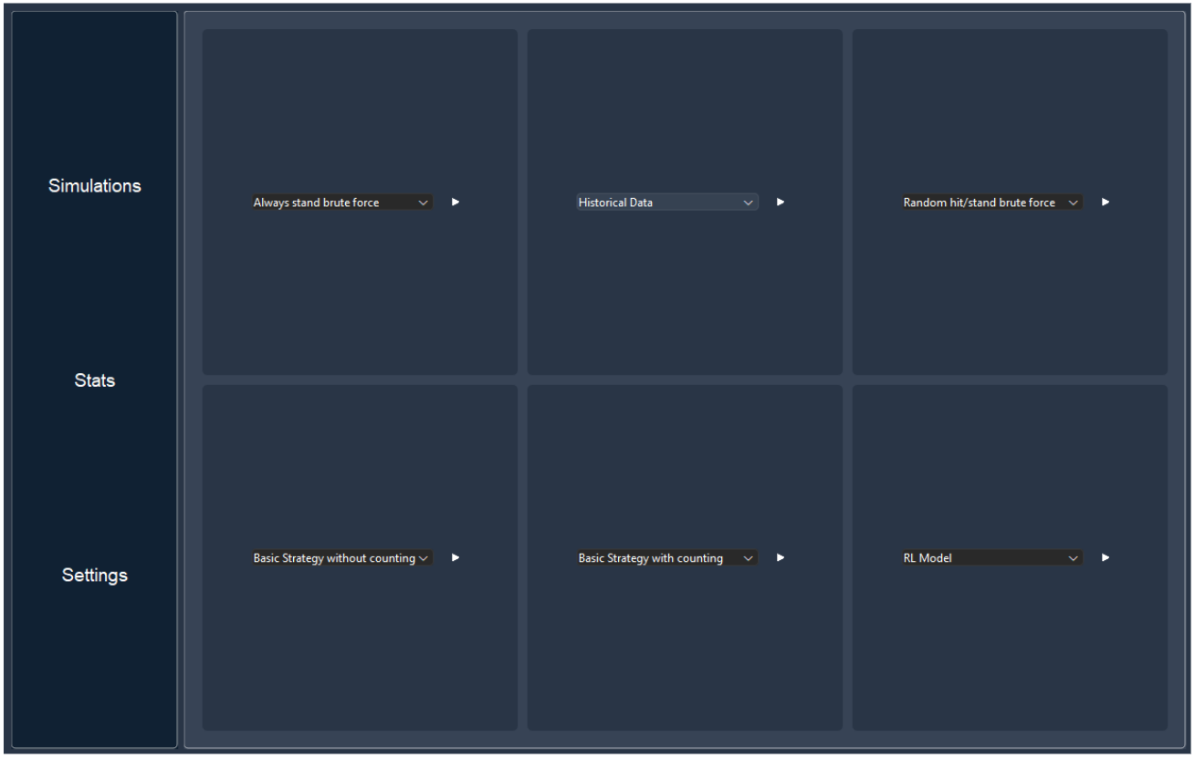
User Interface : Simulation Screen
Figure 3.1 : User Interface : Simulation Screen
Deniz Genco ATILLA | 20200702098

Slide 31
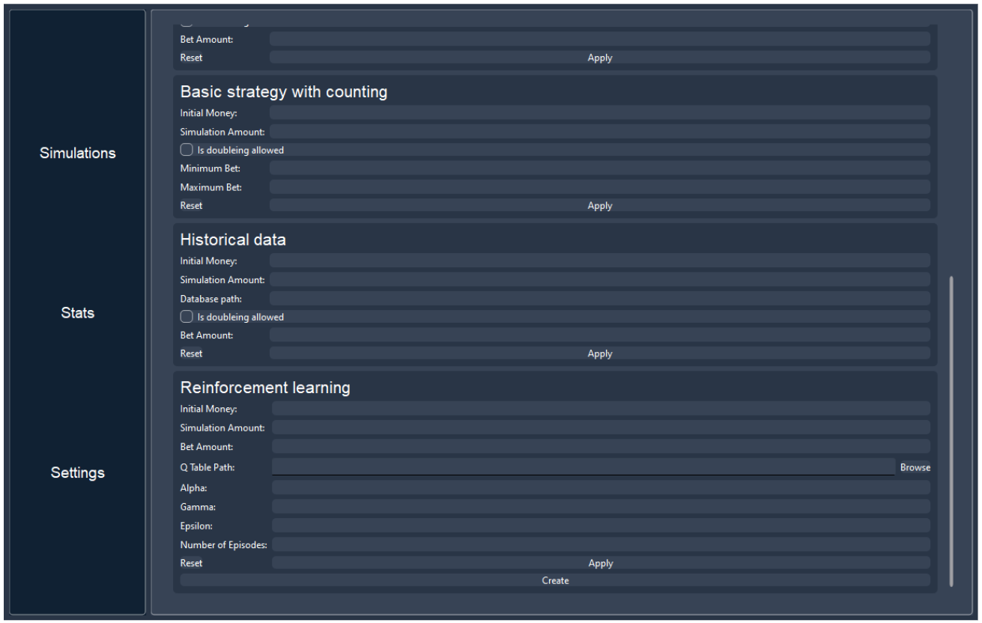
User Interface : Settings Screen
Figure 3.2 : User Interface : Settings Screen
Deniz Genco ATILLA | 20200702098

Slide 32
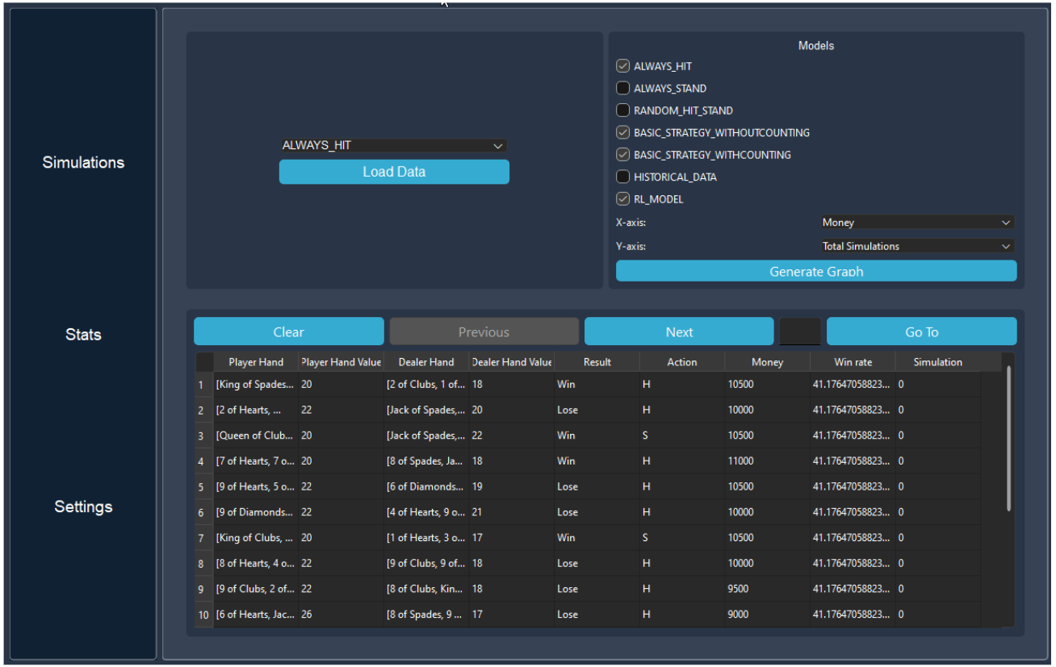
User Interface : Stats Screen
Figure 3.3 : User Interface : Stats Screen
Deniz Genco ATILLA | 20200702098

Slide 33
Test and Results
Deniz Genco ATILLA | 20200702098

Slide 34
Test and Results Outline
Comparing Brute Force Algorithms
Always Hit
Always Stand
Random Hit/Stand
Comparing Basic Strategy Algorithms
Basic Strategy without Card Counting
Basic Strategy with Card Counting
Comparing Historical Data Algorithm
Comparing RL Algorithm
Deniz Genco ATILLA | 20200702098

Slide 35
Comparing Algorithms
In this section, different algorithms —Always Hit, Always Stand, and Random Hit/Stand, Basic Strategy models with and without Counting, Historical Data and RL— will be tested in terms of win rate, loss rate, money change over win rate, and average return on investment for each model.
All the following algorithms are ran in these parameters:
Initial Money : 10000
Simulation Amount : 2000
Bet Amount : 500
Hit/Stand Threshold (For always hit model) : 17 (by default)
Deniz Genco ATILLA | 20200702098

Slide 36
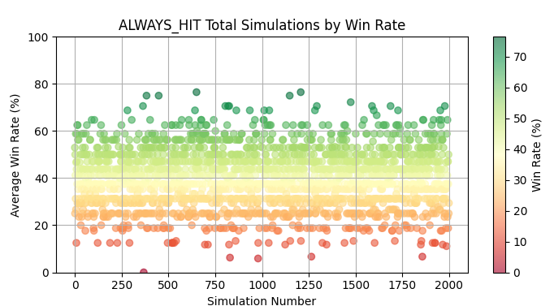
Always Hit Brute Force – Win Rate x Total Simulations
Figure 4.1 : Always Hit Model : Win rate x Total Simulations
Deniz Genco ATILLA | 20200702098

Slide 37
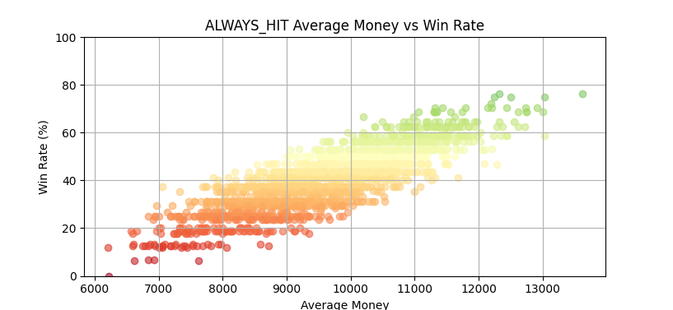
Always Hit Brute Force – Money x Win Rate
Figure 4.2 : Always Hit Model : Money x Win Rate
Deniz Genco ATILLA | 20200702098

Slide 38
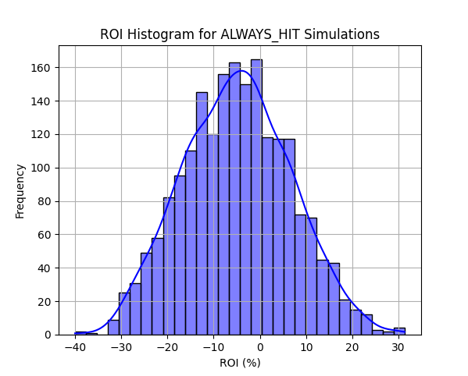
Always Hit Brute Force – ROI x Frequency
Figure 4.3 : Always Hit Model : ROI x Frequency
Deniz Genco ATILLA | 20200702098

Slide 39
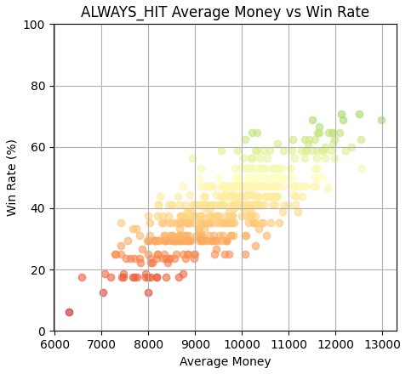
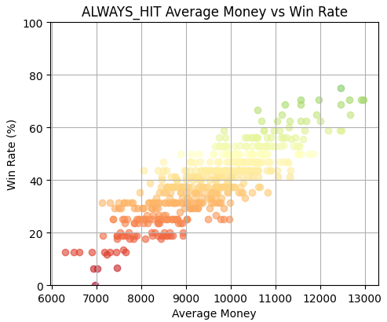
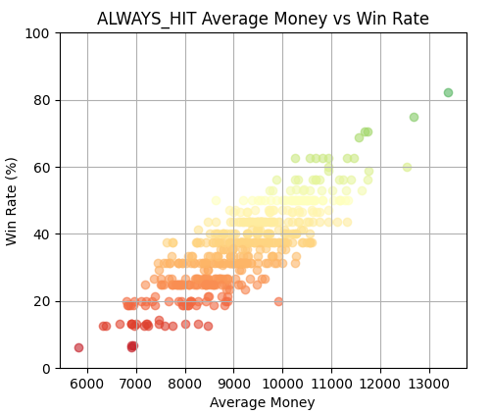
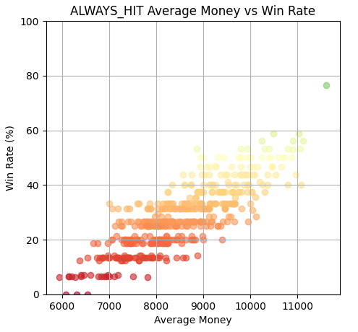
Always Hit Brute Force – Comparing Different Thresholds
16
17
18
19
Figure 4.4 : Comprehension of always hit brute force model for thresholds 16, 17, 18 and 19
Deniz Genco ATILLA | 20200702098

Slide 40
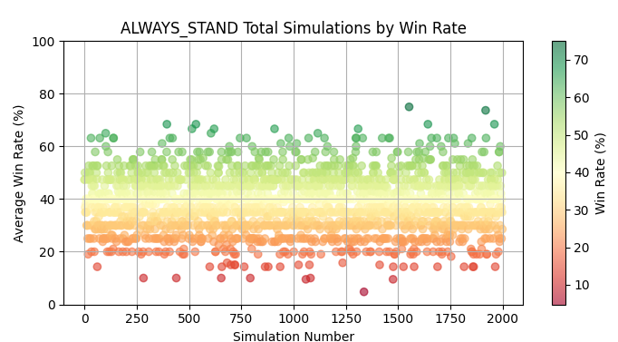
Always Stand Brute Force – Win rate x Total Simulations
Figure 4.5 : Always Stand Model : Win rate x Total Simulations
Deniz Genco ATILLA | 20200702098

Slide 41
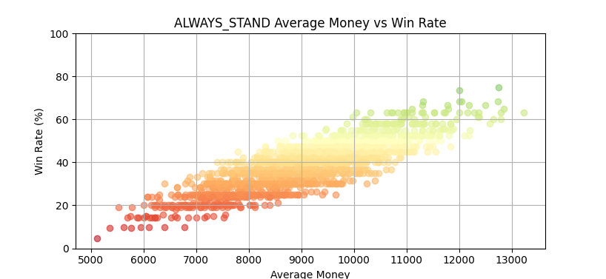
Always Stand Brute Force – Money x Win Rate
Figure 4.6 : Always Stand Model : Money x Win Rate
Deniz Genco ATILLA | 20200702098

Slide 42
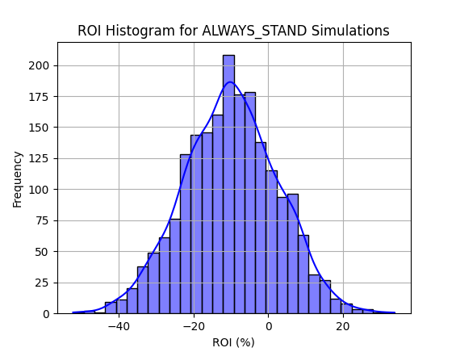
Always Stand Brute Force – ROI x Frequency
Figure 4.7 : Always Stand Model : ROI x Frequency
Deniz Genco ATILLA | 20200702098

Slide 43
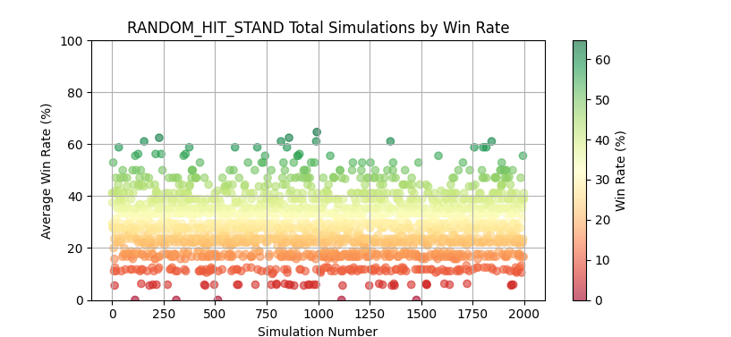
Random Hit/Stand Brute Force – Win Rate x Total Simulations
Figure 4.8 : Random Hit/Stand Model : Win rate x Total Simulations
Deniz Genco ATILLA | 20200702098

Slide 44
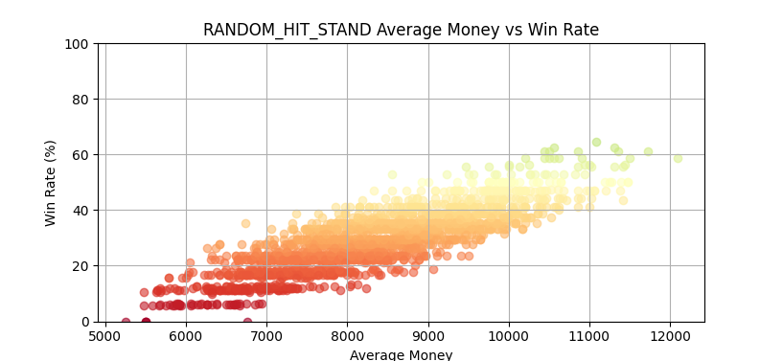
Random Hit/Stand Brute Force – Money x Win Rate
Figure 4.9 : Random Hit/Stand Model : Money x Win Rate
Deniz Genco ATILLA | 20200702098

Slide 45
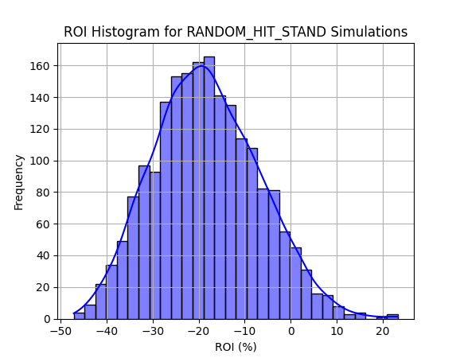
Random Hit/Stand Brute Force – ROI x Frequency
Figure 4.10 : Random Hit/Stand Model : ROI x Frequency
Deniz Genco ATILLA | 20200702098

Slide 46
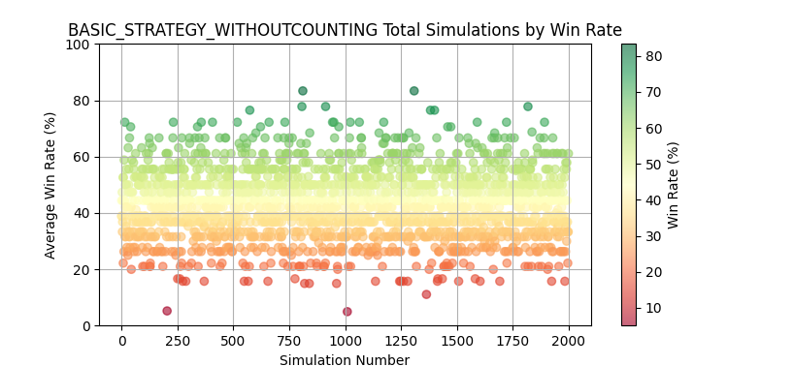
Basic Strategy without Card Counting – Win Rate x Total Simulations
Figure 4.11 : Basic Strategy without Card Counting Model : Win rate x Total Simulations
Deniz Genco ATILLA | 20200702098

Slide 47
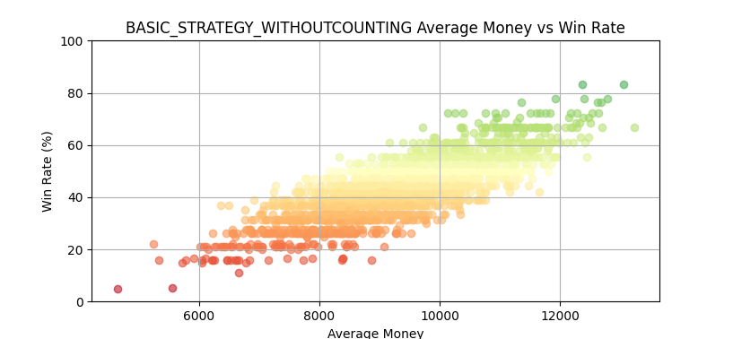
Basic Strategy without Card Counting – Money x Win Rate
Figure 4.12 : Basic Strategy without Card Counting Model : Money x Win Rate
Deniz Genco ATILLA | 20200702098

Slide 48
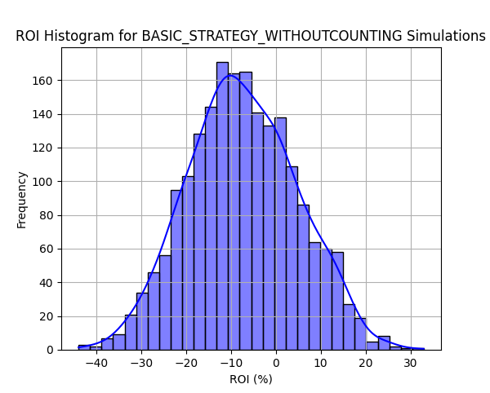
Basic Strategy without Card Counting – ROI x Frequency
Figure 4.13 : Basic Strategy without Card Counting Model : ROI x Frequency
Deniz Genco ATILLA | 20200702098

Slide 49
Comparison between Basic Strategy w/o Counting and Brute Force Always Hit
Figure 4.14 : Comparison between Basic Strategy w/o Counting and Brute Force Always Hit : ROI x Frequency
Deniz Genco ATILLA | 20200702098

Slide 50
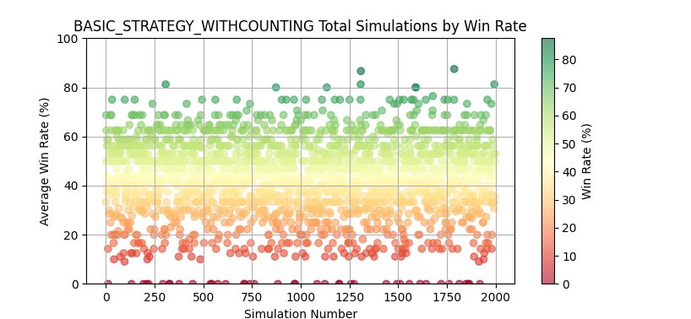
Basic Strategy with Card Counting – Win Rate x Total Simulations
Figure 4.15 : Basic Strategy with Card Counting Model : Win rate x Total Simulations
Deniz Genco ATILLA | 20200702098

Slide 51
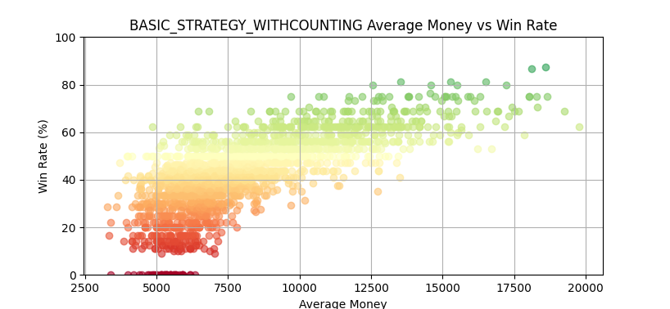
Basic Strategy with Card Counting – Money x Win Rate
Figure 4.16 : Basic Strategy without Card Counting Model : Money x Win Rate
Deniz Genco ATILLA | 20200702098

Slide 52
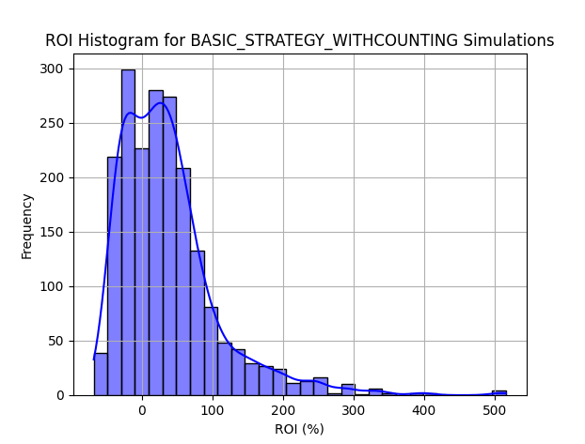
Basic Strategy with Card Counting – ROI x Frequency
Figure 4.17 : Basic Strategy with Card Counting Model : ROI x Frequency
Deniz Genco ATILLA | 20200702098

Slide 53
Comparison between Basic Strategy w/o Counting and with Counting – ROI x Frequency
Figure 4.18 : Comparison between Basic Strategy w/o Counting and with Counting : ROI x Frequency
Deniz Genco ATILLA | 20200702098

Slide 54
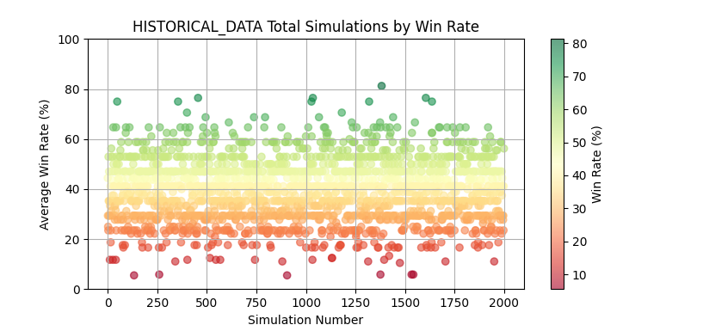
Historical Data – Win Rate x Total Simulations
Figure 4.19 : Historical Data Model : Win rate x Total Simulations
Deniz Genco ATILLA | 20200702098

Slide 55
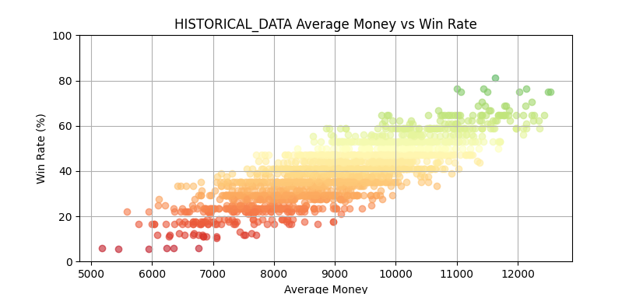
Historical Data – Money x Win Rate
Figure 4.20 : Historical Data Model : Money x Win Rate
Deniz Genco ATILLA | 20200702098

Slide 56
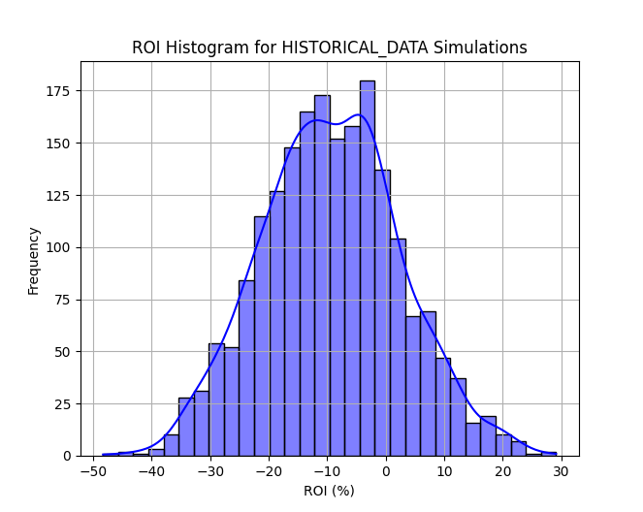
Historical Data – ROI x Frequency
Figure 4.21 : Historical Data Model : ROI x Frequency
Deniz Genco ATILLA | 20200702098

Slide 57
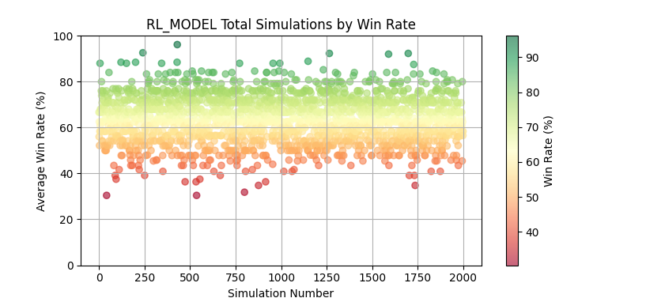
Reinforcement Learning – Win Rate x Total Simulations
Figure 4.22 : Reinforcement Learning Model : Win rate x Total Simulations
Deniz Genco ATILLA | 20200702098

Slide 58
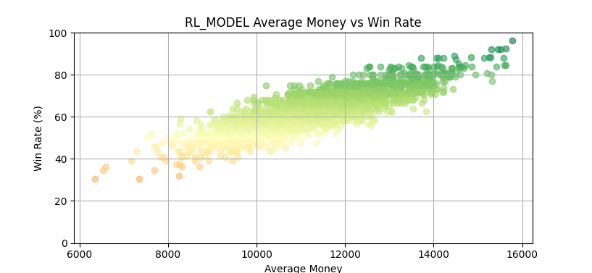
Reinforcement Learning – Money x Win Rate
Figure 4.23 : Reinforcement Learning Model : Money x Win Rate
Deniz Genco ATILLA | 20200702098

Slide 59
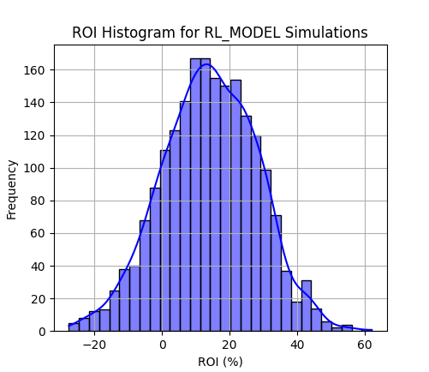
Reinforcement Learning – ROI x Frequency
Figure 4.21 : Reinforcement Learning Model : ROI x Frequency
Deniz Genco ATILLA | 20200702098

Slide 60
Comparison between Basic Strategy with Counting and RL – ROI x Frequency
Figure 4.22 : Comparison between Basic Strategy with Counting and RL : ROI x Frequency
Deniz Genco ATILLA | 20200702098

Slide 61
Conclusion
Brute force methods, show fundamental differences in their win rates and ROI. Among these, the always hit strategy demonstrates the best performance, when its hit threshold set wisely.
Basic strategy models, both with and without card counting, offer significant improvements over brute force methods. The basic strategy with counting model, shows higher win rates and potential for larger profits due to its adaptive betting strategy. However, this model also exhibits greater volatility, with notable outliers due to its aggressive betting behavior when the true count is high.
The reinforcement learning (RL) model stands out as the most consistent and profitable strategy. Trained using a variety of hyper-parameters, the RL model not only achieves high win rates but also maintains a balanced ROI across simulations.
Historical data models, while informative, do not perform as well as the RL and counting strategies. Their reliance on past data leads to mixed results, with performance heavily dependent on the specific dataset used.
Deniz Genco ATILLA | 20200702098

Slide 62
Conclusion
In summary, while the basic strategy with counting can achieve high returns in certain conditions, the reinforcement learning model proves to be the most effective overall, offering a balance of high win rates and consistent ROI. Further optimization of hyper-parameters could enhance the RL model’s performance even more, solidifying its position as the best strategy for blackjack gameplay.
Deniz Genco ATILLA | 20200702098

Slide 63
Future Work
Several enhancements and extensions can be implemented to improve the current system and provide a more comprehensive analysis of blackjack strategies:
The GUI can be made more user-friendly and responsive, offering better feedback to users. For instance, incorporating sounds to notify users when simulations are complete would enhance the user experience.
The current graph creation screen can be slow when handling large datasets. For example, creating a graph with 2000 simulations, each with approximately 30 games, results in processing around 60,000 games, which can cause lag. Developing a custom graphing system could mitigate these performance issues.
Expansion of Brute Force Models: New brute force models, such as ”always doubling” or ”imitate dealer/match dealer” [10] can be added to the system. Alternatively, these strategies can be integrated into existing models to provide a broader range of simulation options.
Implementing features like insurance and surrendering could offer a more complete basic strategy model. Although these features may not significantly impact the results in 2000 simulations, their inclusion would provide a more accurate representation of real gameplay. Additionally, different counting strategies beyond the HI-LO method could be used, offering users the ability to select and compare various counting methods through the settings.
Deniz Genco ATILLA | 20200702098

Slide 64
Future Work
Access to better historical data would significantly enhance the accuracy and reliability of the historical data model. However, due to the restrictive nature of casinos regarding this information, obtaining such data may be challenging. If viable methods to access more comprehensive historical data are found, they should be increase the performance of the model.
The RL model can be further refined by incorporating additional actions, beyond just hit, stand, and doubling. Exploring other RL algorithms and comparing their performance could yield valuable insights. Additionally, a real-time learning model that updates based on the current data during gameplay could be developed.
Deniz Genco ATILLA | 20200702098

Slide 65
Bibliography
[1] A. J. Barr. A. R. Manson and J. H. Goodnight, “Optimum zero-memory strategy and exact probabilities for 4-deck blackjack,” The American Statistician, vol. 29, no. 2, pp. 84–88, 1975. DOI: 10.1080/00031305.1975.10477376.
[2] M. Dresher and E. O. Thorp, “Beat the dealer: A winning strategy for the game of twenty-one,” Mathematics of Computation, vol. 18, no. 86, p. 331, 1964. [Online]. Available: https://doi.org/10.2307/2003323.
[3] J. Archer, The Archer Method of Playing 21. Wilshire Book Company, 1973.
[4] A. Perez-Uribe and E. Sanchez, “Blackjack as a test bed for learning strategies in neural networks,” vol. 3, 2022–2027 vol.3, 1998. DOI: 10.1109/IJCNN.1998.687170.
[5] S. Yakowitz and M. Kollier, “Machine learning for optimal blackjack counting strate-gies,” Journal of Statistical Planning and Inference, vol. 33, no. 3, pp. 295–309, Dec.1992. DOI: 10.1016/0378-3758(92)90001-9. [Online]. Available: https://doi.org/10.1016/0378-3758(92)90001-9.
[6] Basic Strategy Multiple-Deck Chart [Online] Available : https://www.blackjackreview.com/wp/encyclopedia/multiple-deck
[7] D. Ho. “50 million blackjack hands.” (2021), [Online]. Available: https : / / www .kaggle.com/datasets/dennisho/blackjack- hands/data.
Deniz Genco ATILLA | 20200702098

